Slide 1
Northern New England Poison Center www.nnepc.org
Emerging Issues in
Substance Abuse
Gayle Finkelstein, MS RN
Vermont Education Coordinator
Northern New England Poison Center

Slide 2
Objectives
Review history of poison centers and Northern New England Poison Center services
Discuss poisoning data
Highlight emerging drugs of abuse
Review resources

Slide 3
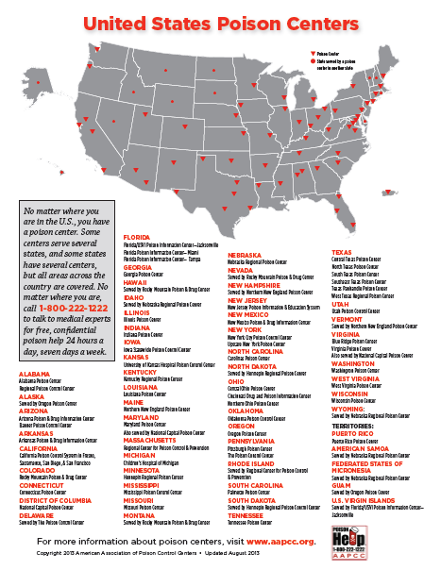

Slide 4
NNEPC Services
Regional center serving Maine, New Hampshire & Vermont
Nationally certified by the American Associations of Poison Control Centers (AAPCC)
Available 24/7
Free and confidential
On-line chat available
TTY and Translation services available
Education programs and materials available on-line

Slide 5
NNEPC Mission
Prevent poisonings
Minimize the effects of poisonings that have occurred
Reduce health care costs
Educate general public and health care providers about poison prevention and poisoning management

Slide 6
Data Collection
30 + years Data repository for all US poison centers
  Real time data capture
2012: All poison centers upload data automatically to NPDS
NPDS data base contains over 400,000 products ranging from viral and bacterial agents to commercial chemical and drug products
  Continuously updated
Notes:
Uploaded data every 8 minutes and provides near real time snapshot of poison call conditions nationwide (national exposure data base and surveillance system) On average US PC’s receive a call on human exposures every 14.4.seconds

Slide 7
The Poison Center—Your regional toxicology experts available 24/7
Provide onsite treatments consultations, transport recommendations and communicate clinical treatment guidelines to destination hospital – HIPAA approved
Locate nearby laboratory facilities and secure necessary antidotes
Identify unknown pills
Find up-to-date information resources including real-time national surveillance and local data/trends
Provide interpretation service in 161 languages and can also assist with callers who are deaf or hearing impaired

Slide 8
NNEPC Services
Participates in national near real-time public health surveillance for mass poisoning events, outbreaks and poisoning trends
Participate in drills with hospitals, health departments and others to test emergency procedures.
Works with local, state and federal organizations to prepare and respond to emergencies (terrorist attacks, industrial accidents, natural disasters).

Slide 9
NNEPC is HIPAA Compliant
Health Insurance Portability & Accounting Act
“We note that poison centers are health care providers for the purpose of this rule. We consider the counseling and follow-up consultations provided by poison control centers with individual providers regarding patient outcomes to be treatment. Therefore poison control centers and other health care providers can share protected health information about the treatment of an individual without a business associate contract.”
Federal Register, December 28, 2000 (65 FR 824462), p. 82,626.

Slide 10
Call Management
Three management options:
No treatment necessary
In-home treatment advice (e.g., eye flush)
  Every $1 spent on Poison centers
  saves $13 in health care costs by
  resolving cases with in-home treatment
Referral to physician or emergency department depending on severity. Direct link to 911

Slide 11
History of NNEPC
Maine:
  1974: Maine Poison Center began at Togus VA Medical Center
New Hampshire:
  1957: New Hampshire Poison Center began at Dartmouth Hitchcock Medical Center (then known as the Mary Hitchcock Medical Center)
  2004: NNEPC began serving New Hampshire
Vermont:
  1974: Vermont Poison Center began in and was located at Fletcher Allen Hospital in the emergency department
  2002: Maine and Vermont merged to become the Northern New England Poison Center (NNEPC)
NNEPC now located at Maine Medical Center, Portland , Maine
with satellites in Concord, NH and Burlington, VT

Slide 12
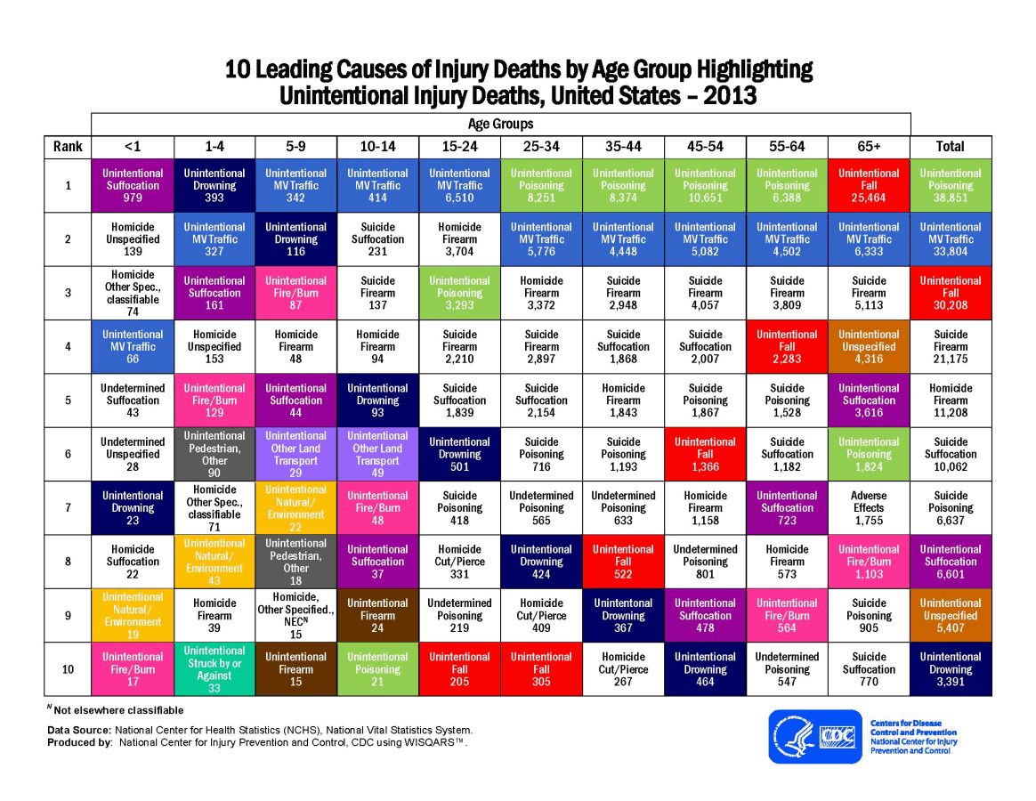

Slide 13
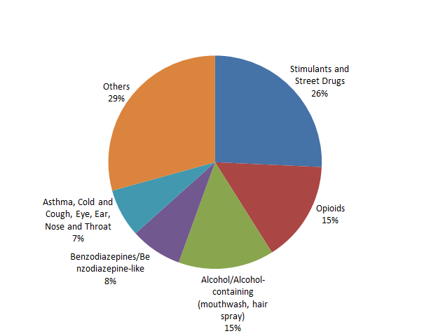
VT Substance Abuse
2012-2014

Slide 14
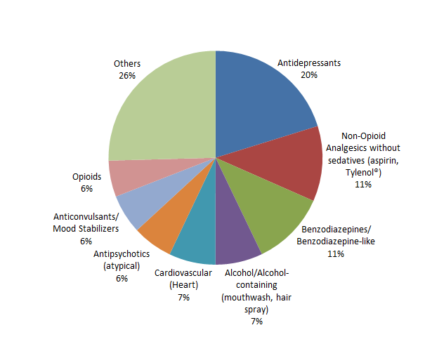
VT Suspected Suicide Attempts
2012-2014

Slide 15
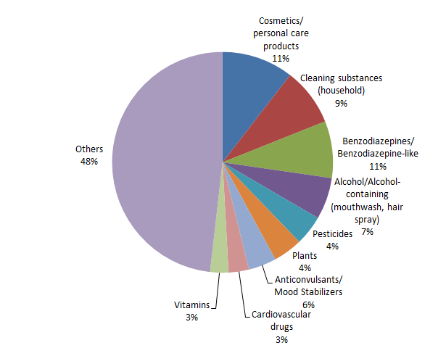
VT Unintentional Exposures
2012- 2014

Slide 16
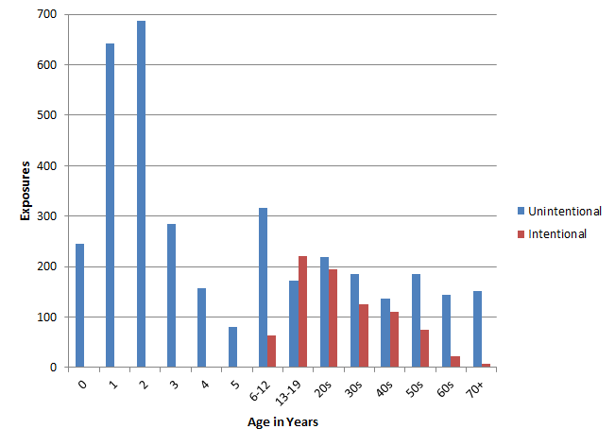
VT Age by Intention, 2014
Notes:
Intentional = substance abuse, suspected suicide attempts and intentional misuse

Slide 17


Slide 18
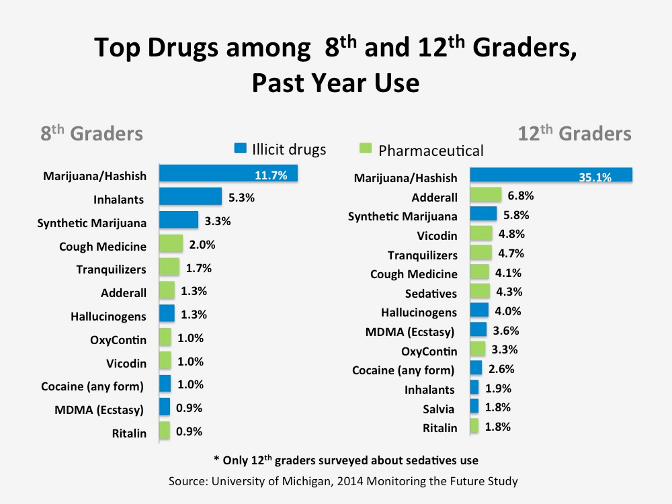
Notes:
http://www.drugabuse.gov/publications/drugfacts/high-school-youth-trends

Slide 19
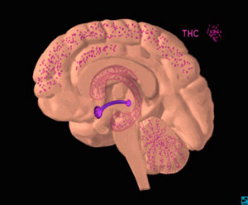

Marijuana
Photos: Drugabuse.gov
Notes:
THC (in magenta) acts on numerous areas in the brain.

Slide 20
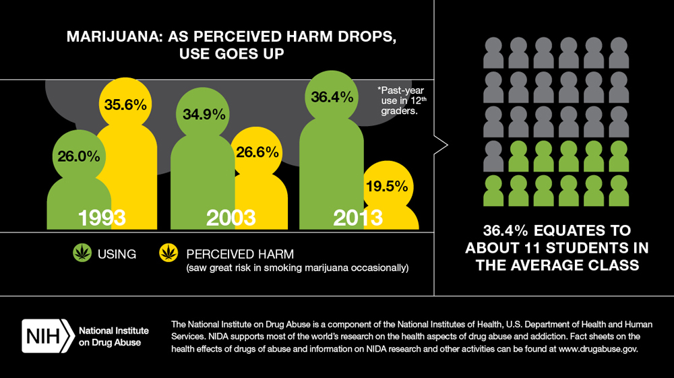
Notes:
http://www.drugabuse.gov/publications/drugfacts/high-school-youth-trends – use this link for national data on drug trends for 2014

Slide 21
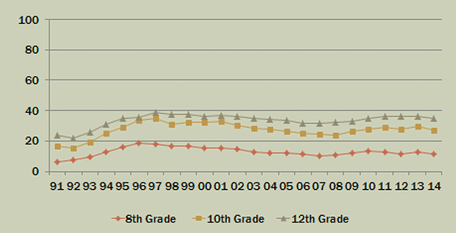
Marijuana Use
Source: Drugabuse.gov
Notes:
http://www.drugabuse.gov/publications/drugfacts/high-school-youth-trends
.

Slide 22
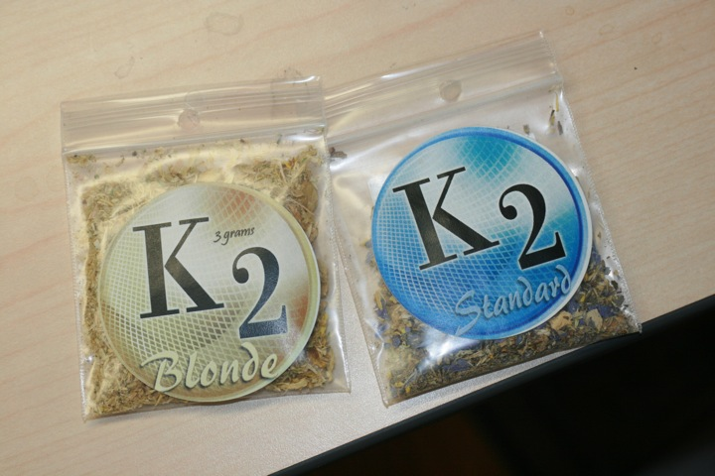
Synthetic Marijuana
Spice, K2
Plant materials treated with synthetic cannabinoids or other chemicals
Sold as herbs, incense, potpourri
Chemically different from THC (same receptors)
Clinical effects vary by substance

Slide 23
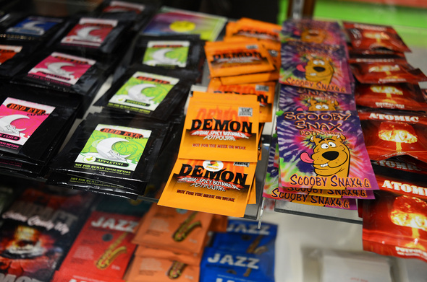
Synthetic Marijuana
heart rate, blood pressure
Anxiety/agitation/ hallucinations
Vomiting
Numbness/tingling
Tremors/seizures
Drowsiness/slurred speech
Pale appearance/dilated pupils

Slide 24
New Concerns
Hundreds of cases in April 2015 in AL, NJ, TX, TN, FL MS, NY requiring hospitalizations
Severe symptoms: high blood pressure, fast and racing heart, seizures, intense hallucinations and psychotic episodes, extreme agitation and anxiety, suicidal and other harmful thoughts/actions
Synthetic cannabinoids, synthetic cathinones, unidentified chemicals
Source: http://www.aapcc.org/press/43/

Slide 25
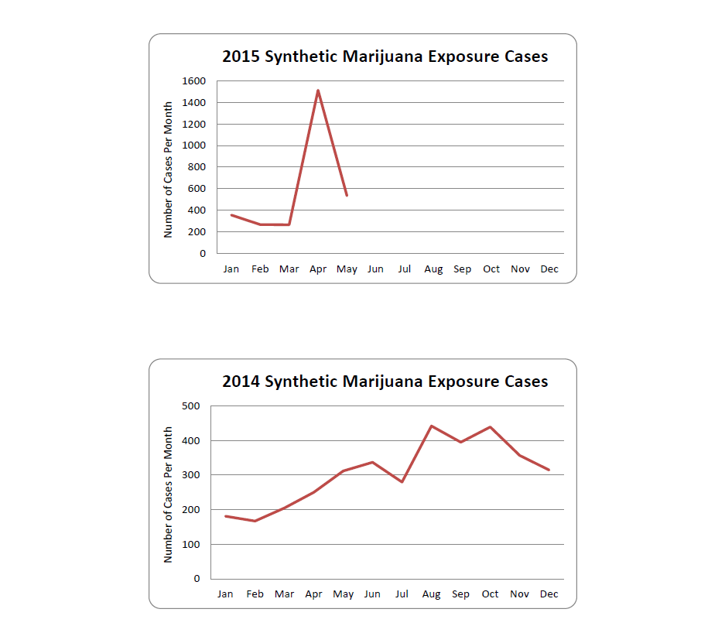
Source: AAPCC

Slide 26
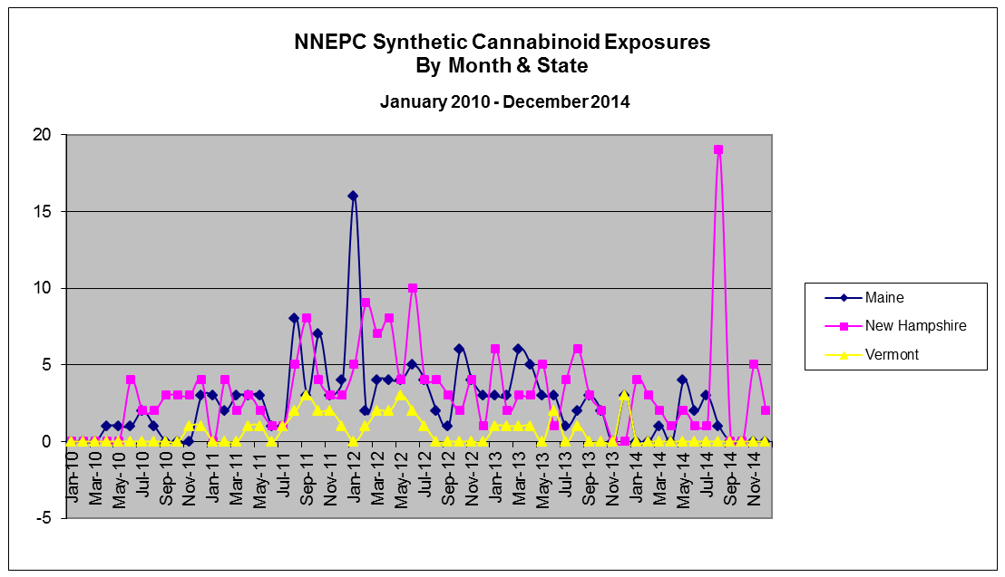
NNEPC Synthetic Cannabinoids

Slide 27
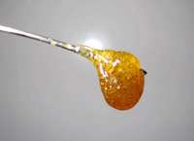
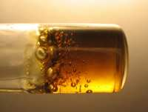
Hash Oil
Photos: VT State Police

Slide 28
Butane Hash oil
Dab or wax
  Increased THC potency (up to 90%)
  Flammable/explosive process
  No scent
  Intense and immediate “high”

Slide 29
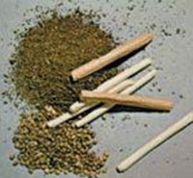
Marijuana Extracts
Smoking THC-rich resins extracted from the marijuana plant is on the rise “dabbing”.
Various forms of these extracts include:
hash oil or honey oil—a gooey liquid
wax or budder—a soft solid with a texture like lip balm
shatter—a hard, amber-colored solid
Deliver large amounts of THC to users emergency room
Danger in preparing these extracts, which usually involves butane (lighter fluid) fires and explosions (burns)
Photo: Drugabuse.gov
Notes:
http://www.drugabuse.gov/publications/drugfacts/marijuana

Slide 30
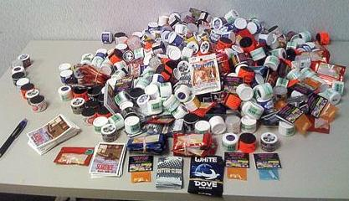
Bath Salts
Photo: Lt. Thomas J. Reagan
Bangor Police Department

Slide 31
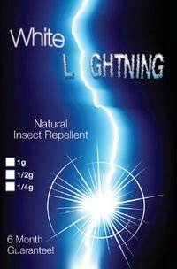
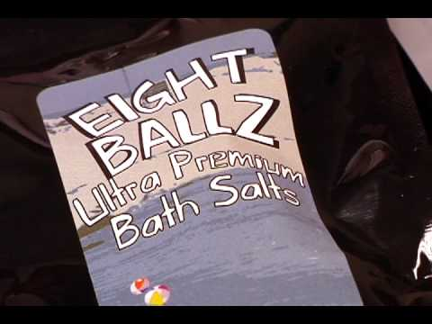
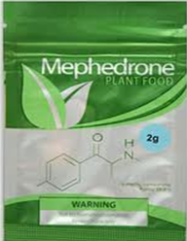
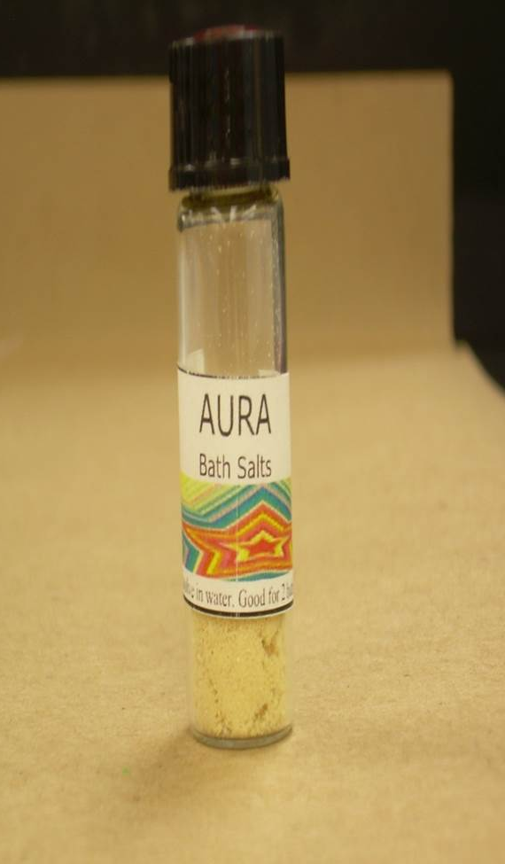
Photos: NH DEA

Slide 32
Bath Salts
A white to tan powder spiked with a psychoactive stimulant
Labeled ‘Bath salts’, ‘spa cleaner’, ‘lady bug attractant’ etc. - sold in packets labeled “not for human consumption”- but are used to get high
  Amphetamine- or methamphetamine-like stimulants
  Chemically similar to cathinones (also stimulants)
  Some have hallucinogenic properties (like Ecstasy)
High blood pressure, fast heart rate, anxiety, hallucinations and muscle breakdown
May induce severe paranoia/violence – dangerous situations

Slide 33
Bath Salts
Bath Salts
Cloud 9
Ivory Wave
Monkey Dust
Monkey Mash
Rave On
Vanilla Sky
White Lightening
Initial:
  MDPV
  Mephedrone
Later:
  Alpha-PVP
  Methylone
Multiple others
Continuing to evolve
Notes:
Synthetic Cathinones

Slide 34
Bath Salts: What to Look For:
Agitation with or without violence
  May be catatonic (lights on – no one home)
  May get violent after catatonic with little-no warning
Paranoia, yelling
Sweat and thirst
Jerky body movements
Grinding of teeth
Euphoria and stimulation for hours
Psychotic for hours to days

Slide 35
Opioids
Natural (opiates)
  Codeine
Semi-synthetic
  Buprenorphine (Suboxone®)
  Butorphanol (Stadol®)
  Heroin
  Hydrocodone (Vicodin®)
Synthetic
  Fentanyl (Sublimaze®)
  Meperidine (Demerol®)
  Morphine
  Hydromorphone (Dilaudid®)
  Oxycodone (Percocet®,
  Tylox®, OxyContin®)
  Pentazocine (Talwin®)
  Methadone
  Propoxyphene (Darvocet®)

Slide 36
NNEPC Medication Verification
Vermont 2012-2014

Slide 37
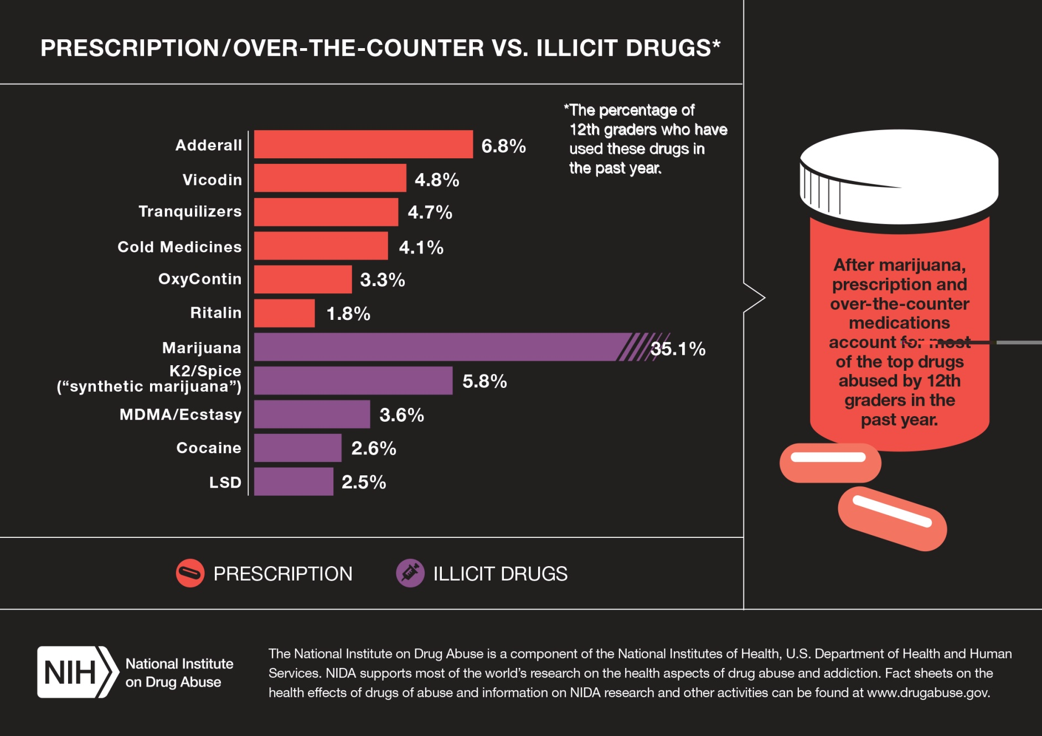

Slide 38
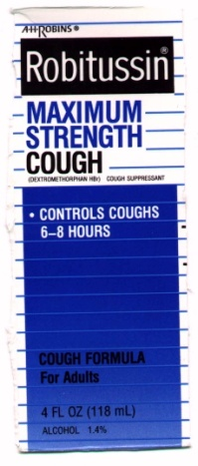
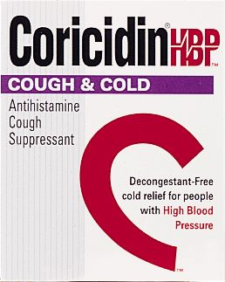
Dextromethorphan (DXM)
  Slang: DXM, RoboTrip or Triple C
  Products: Robitussin DM, Coricidin HBP for Cough and Cold, others
Drowsiness or agitation
Double or blurred vision
Slurred speech
Dizziness

Slide 39
Heroin
Opiate related to morphine
Usually injected (can be snorted, inhaled, smoked)
Clinical effects:
  Euphoria
  Alternate wakeful and drowsy states
  Decreased breathing
  Heart function slows
  Coma
When Rx drugs of abuse unavailable, many will turn to heroin; cheaper, easy to get
Notes:
Drugabuse.gov

Slide 40
Fentanyl laced heroin
Surge in overdose deaths around the country from heroin laced with the powerful narcotic drug fentanyl prompted the Drug Enforcement Administration to issue a nationwide alert in March
Fentanyl - more potent
Law enforcement seizures nationwide of illegal drugs containing fentanyl more than tripled between 2013 and 2014
Vermont State Police officials are warning about the dangers of heroin laced with the drug fentanyl
Since December there have been three confirmed overdose deaths in Vermont linked to heroin laced with fentanyl and another suspected case

Slide 41
Molly
“New”street name (Ecstasy- hype that it is pure MDMA, a synthetic stimulant/hallucinogenic
Often “cut” with other harmful substances
Pills, tablets or capsules
  Agitation
  Paranoia
  Seizures
  Increased heart rate and blood pressure
  Hyperthermia
  Multi-organ failure
  Possible death
Notes:
http://www.drugabuse.gov/drugs-abuse/commonly-abused-drugs-charts-0#mdma

Slide 42
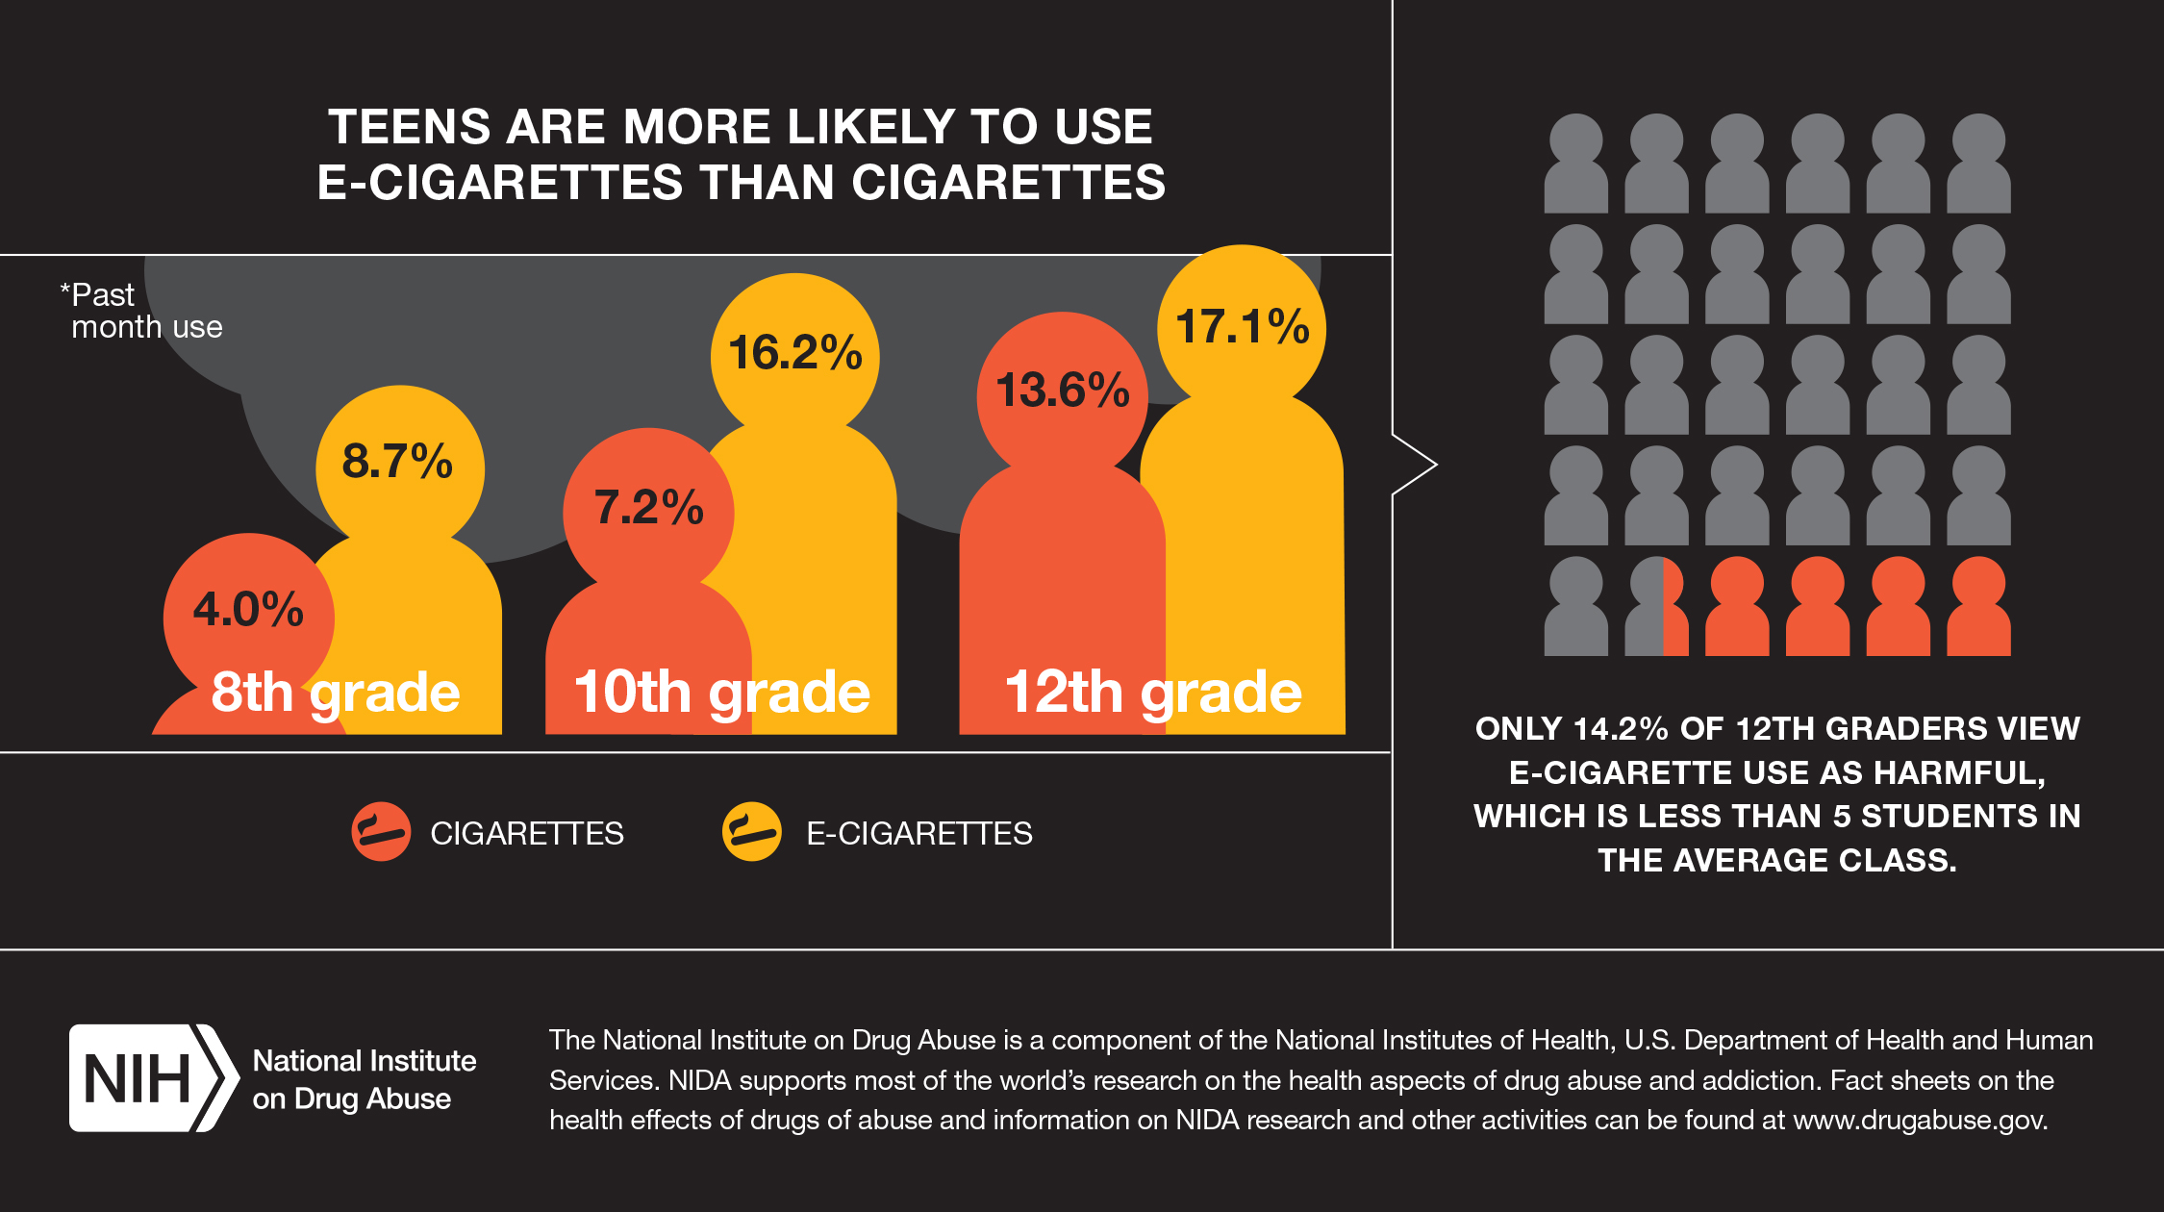

Slide 43
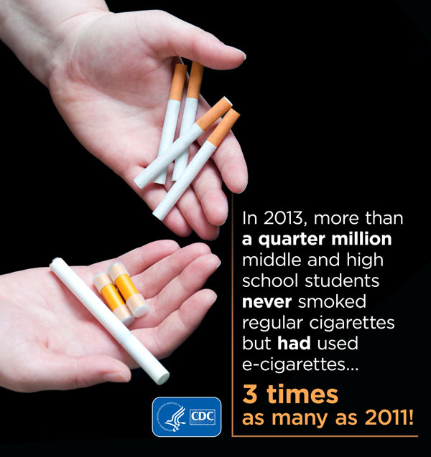
Old vices, new devices
E-cigarette usage rates among teens tripled from 2011-2013.
Study finds youth who have used e-cigarettes are almost twice as likely to have intentions to smoke conventional cigarettes
(http://www.cdc.gov/media/releases/2014/p0825-e-cigarettes.html)

Slide 44
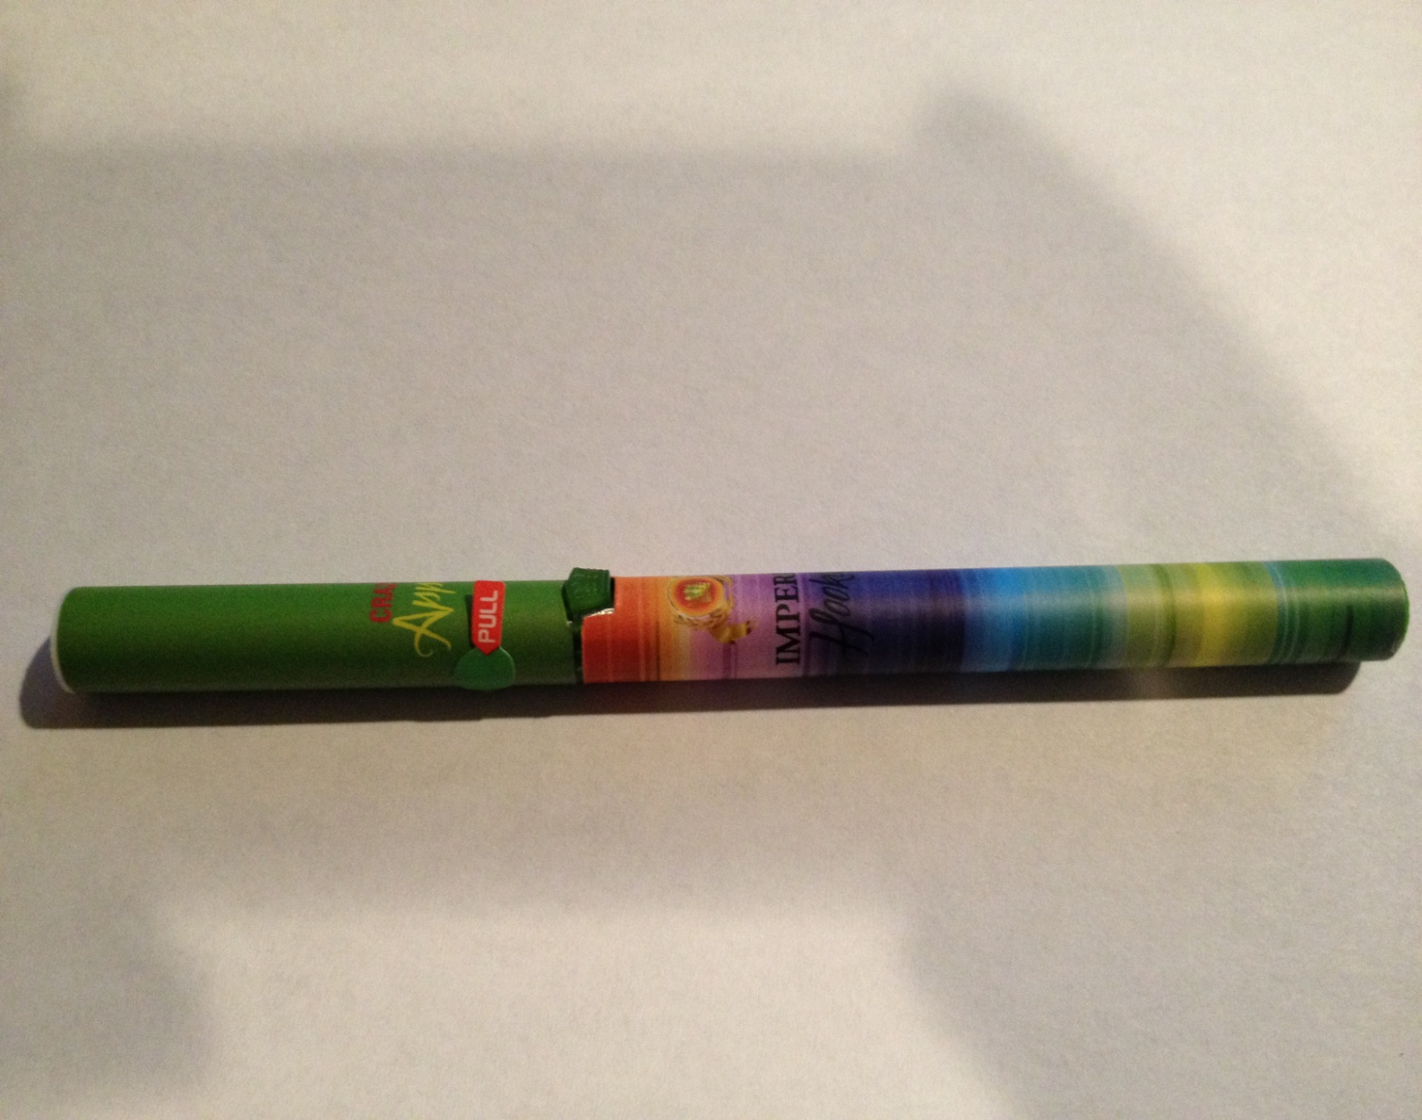
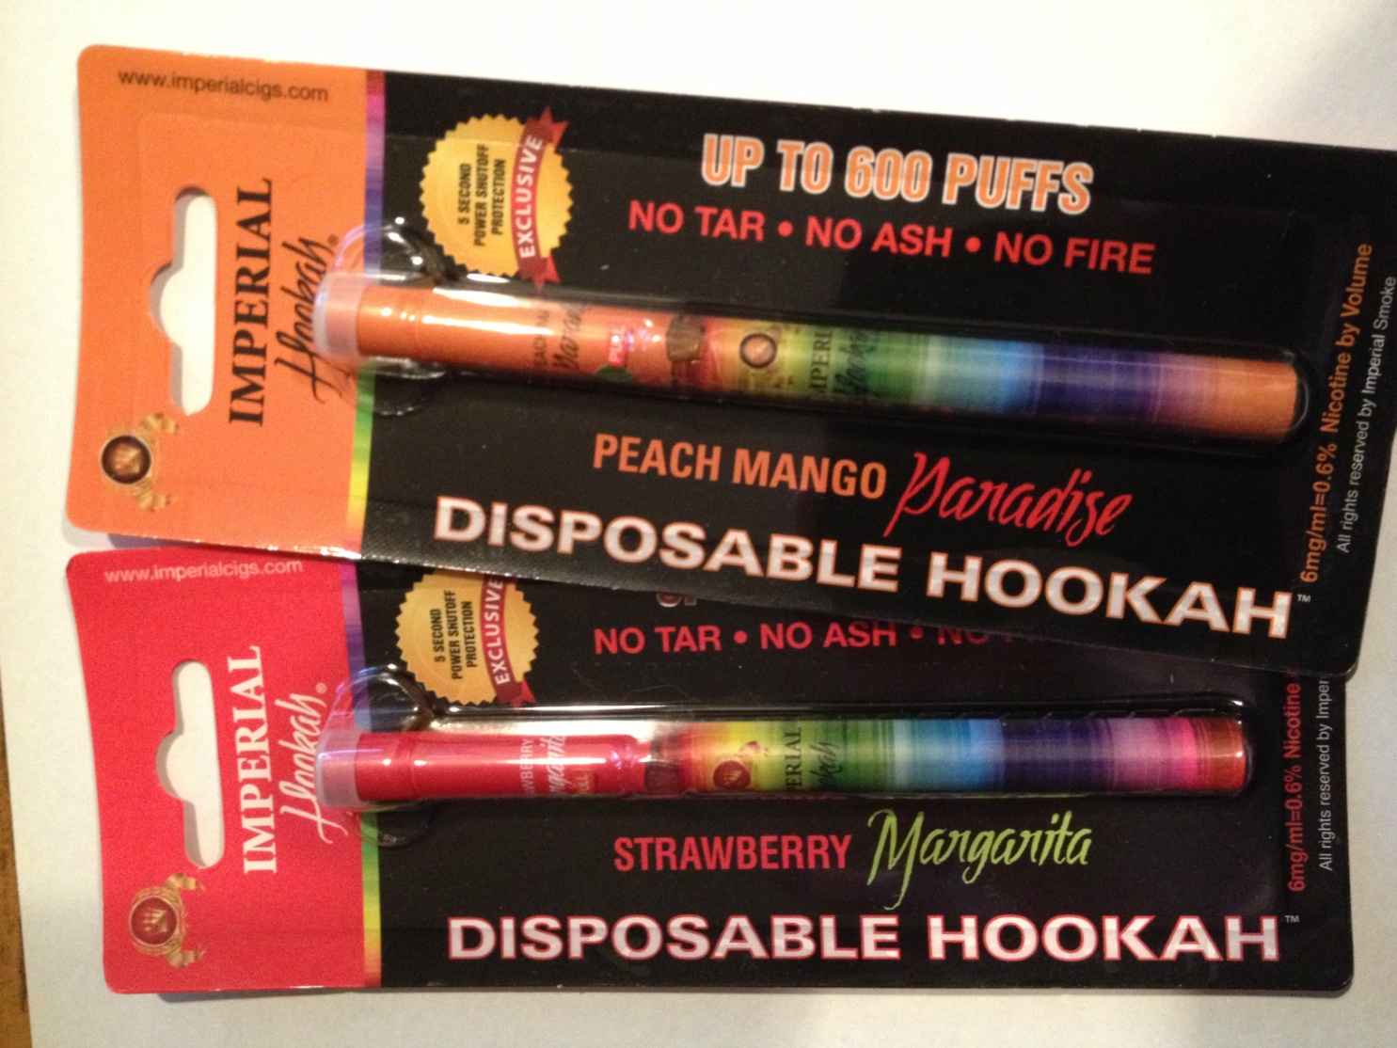
If I found this in my teen’s room, I would never suspect it was a smoking device.
Just pull off the paper tab, press the green button and take a drag. $7.99 at local QuikStop

Slide 45
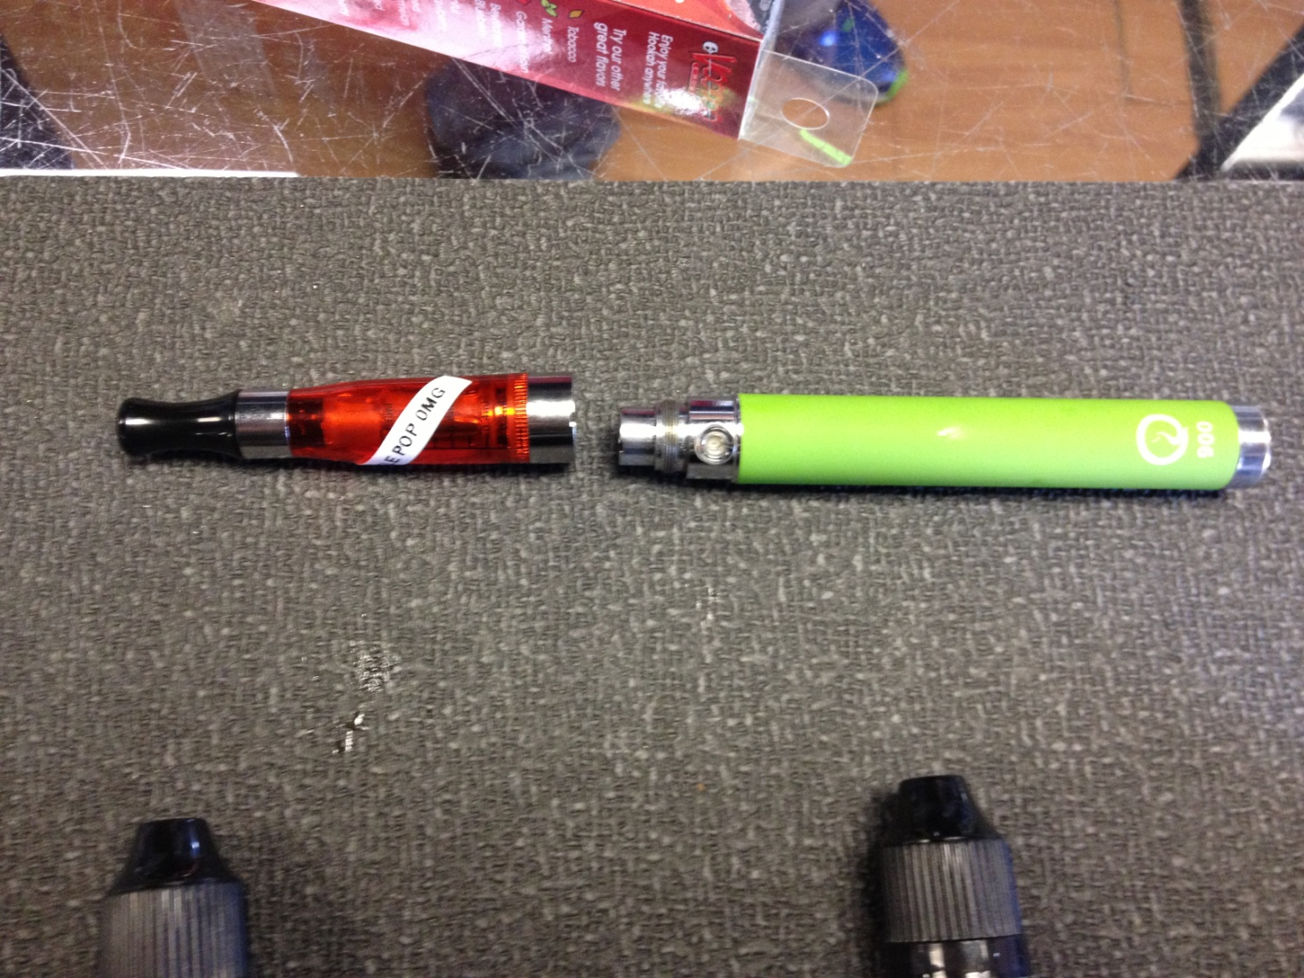
E-cigarette
Liquid is poured into this opening, which heats up enough to create vapor.
Rechargeable battery base, USB port
Mouthpiece

Slide 46
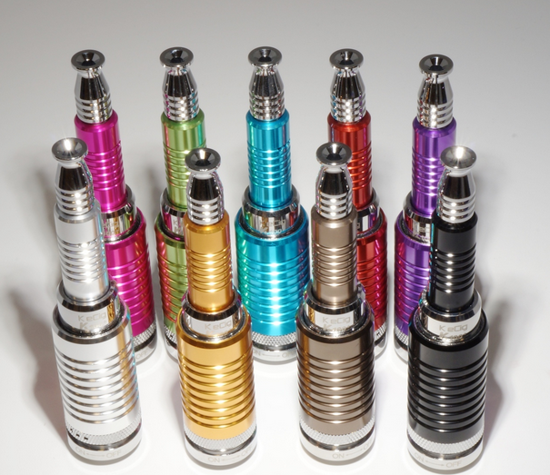
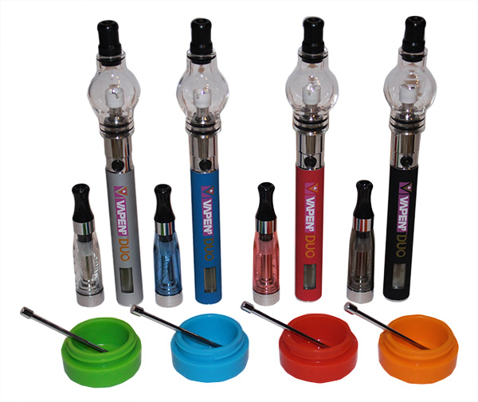
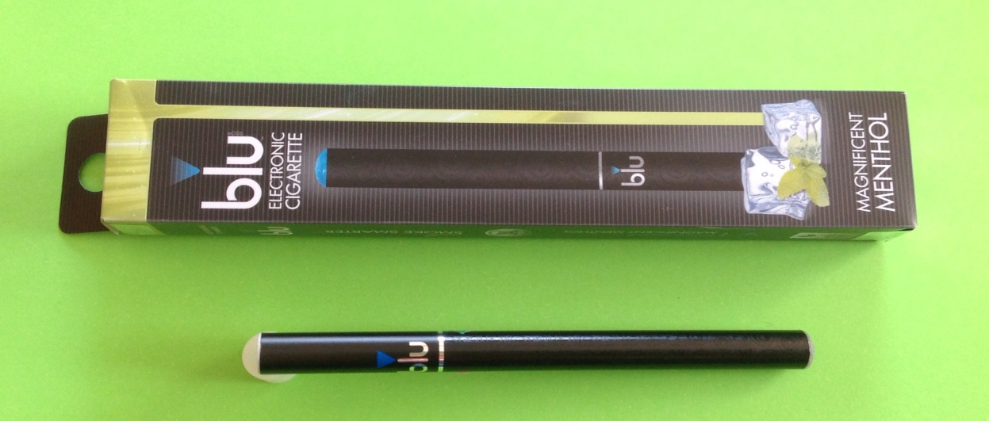
http://www.ecigavenue.com/shop/k100-vaporizer-pen/
“For both oil and wax; USB and Car charger included” Legalbuds.com

These are silicon no-stick pots for ‘dabs’, a waxy or resinous marijuana extract that has concentrated THC.

Slide 47
Nicotine
A naturally occurring stimulant
Increases heart rate, alertness, focus, metabolism
Highly addictive; only medical use is to treat nicotine addiction.

Slide 48
Liquid Nicotine
Traditional cigarette yields about 1 mg of nicotine. Absorption varies by how it is smoked, type of cigarette, etc.
Nicotine readily passes into the bloodstream through skin contact; Spilling liquid nicotine onto skin can cause intoxication, death

Slide 49
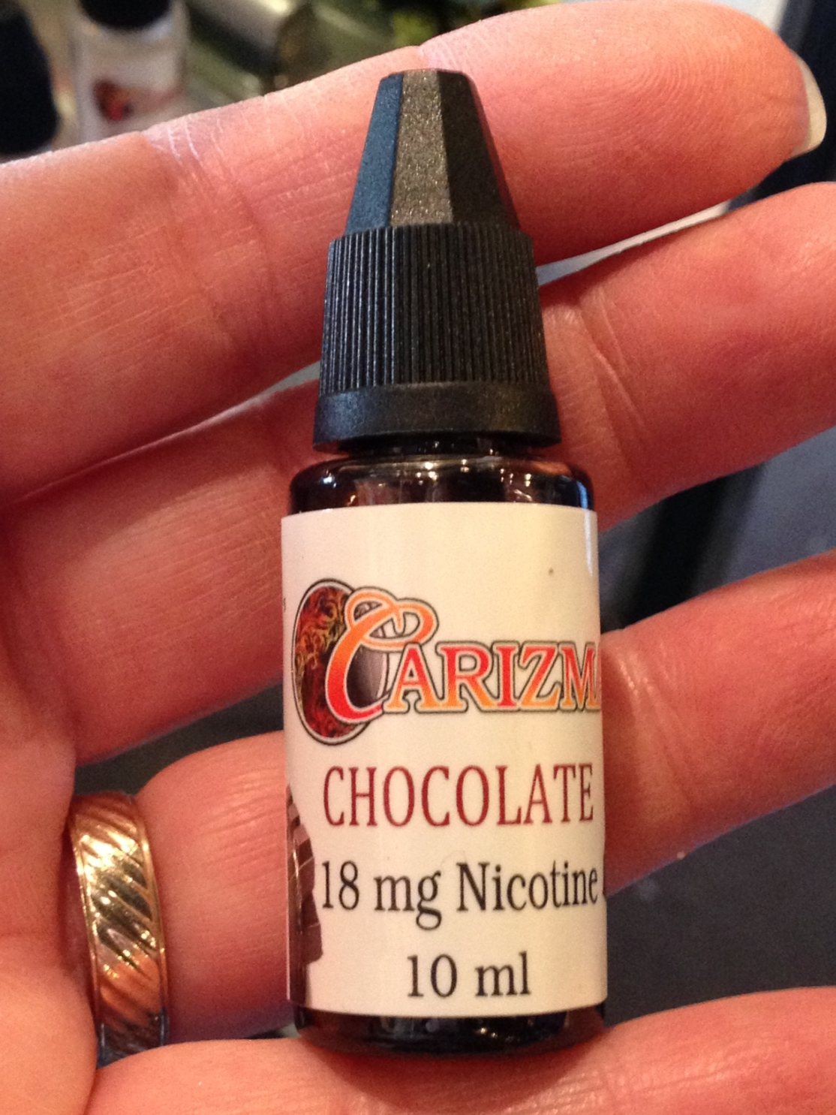
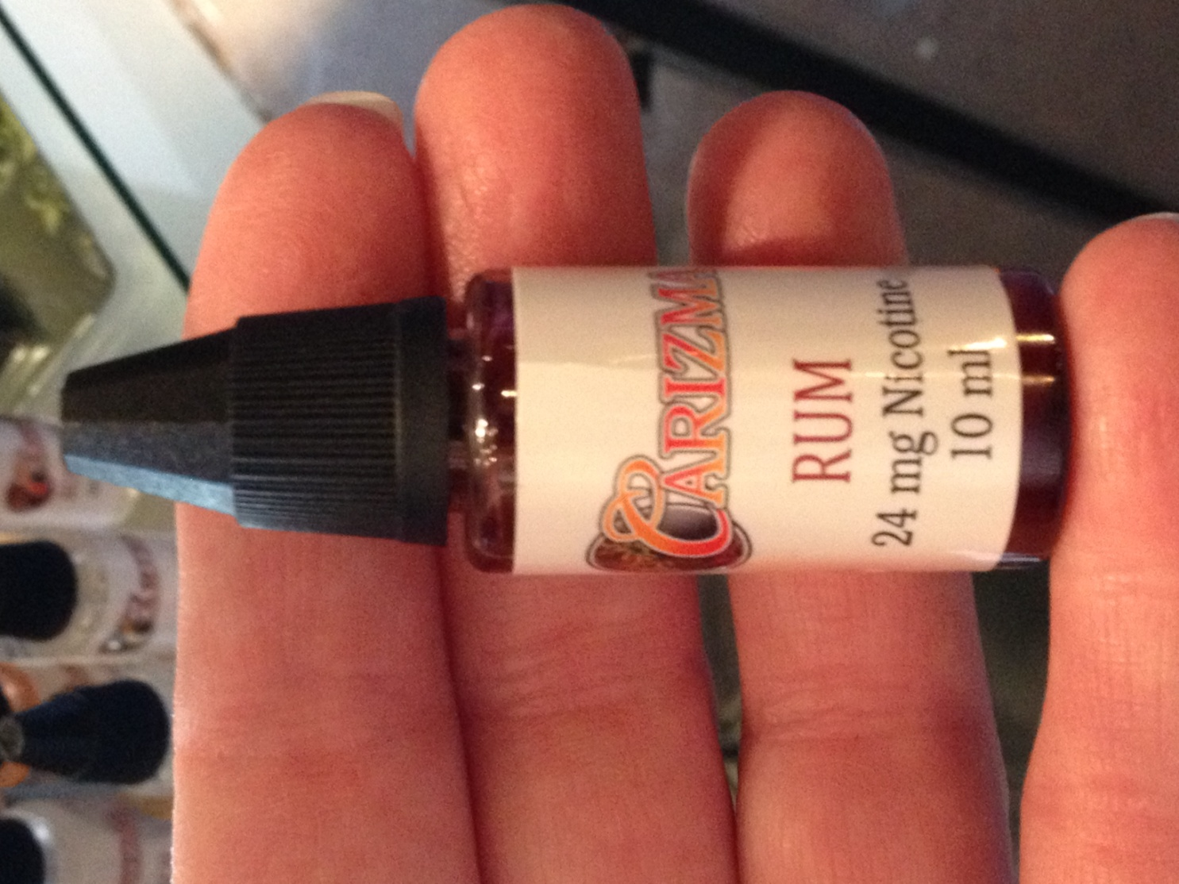
10 ml refill bottle,
18 mg concentration
10 ml refill bottle,
24 mg concentration

Slide 50
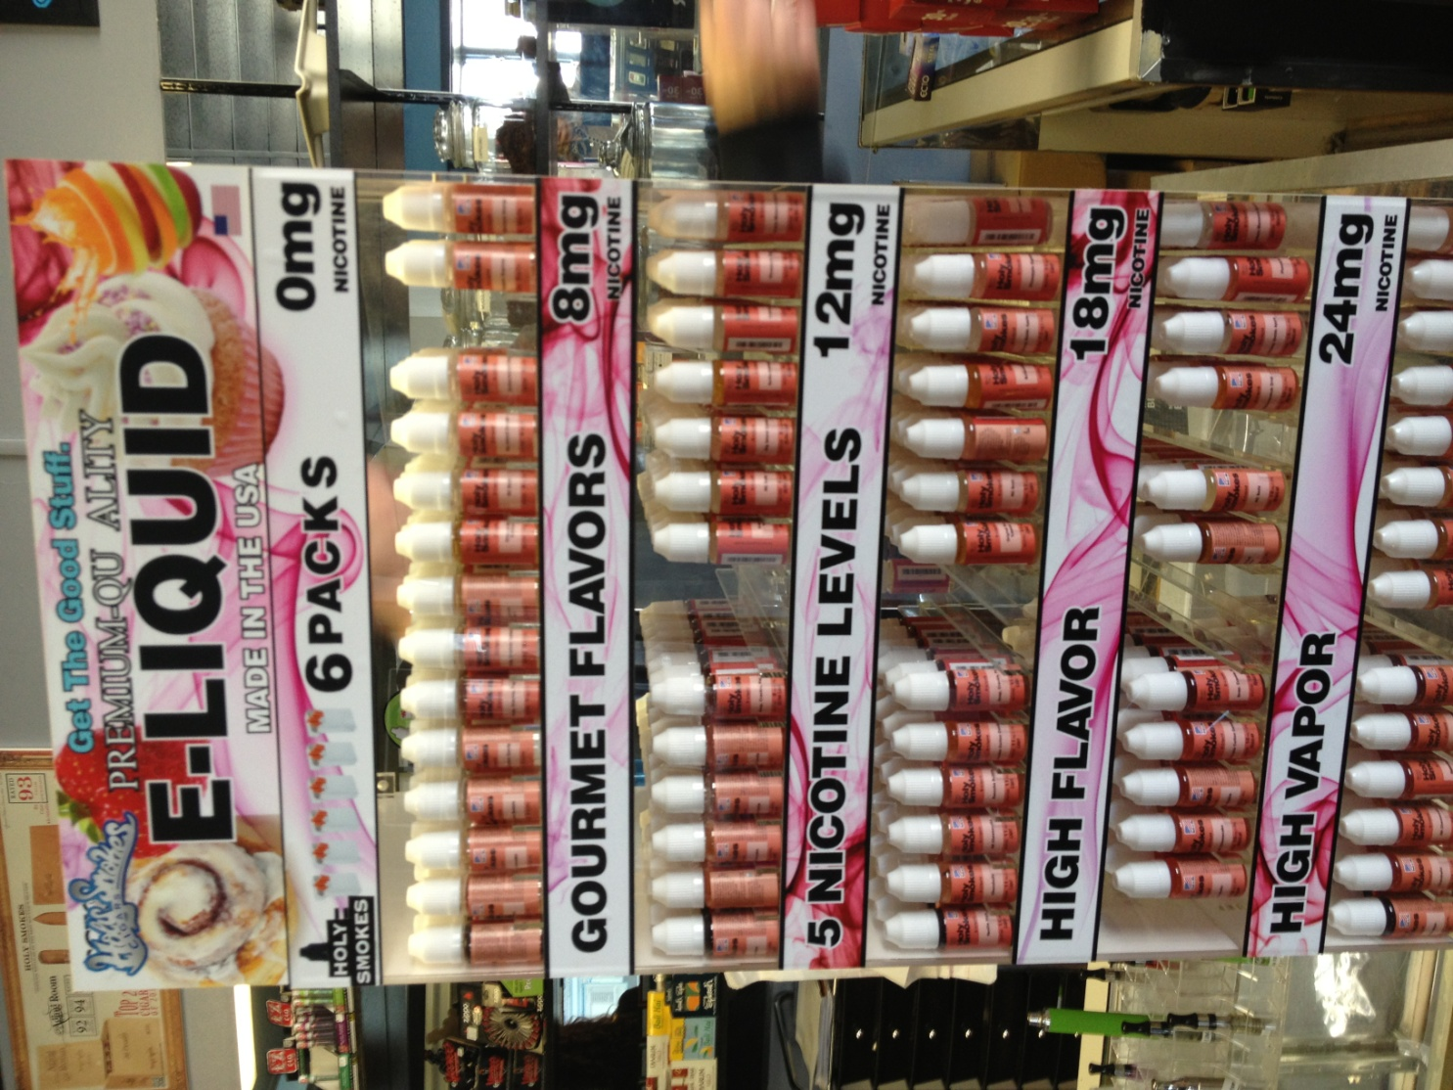
Lots to choose from!
From 0 mg – 24 mg nicotine concentration
Those trying to quit smoking would start ‘vaping’ with higher nicotine content, gradually reduce to 0.
There is no concrete evidence that this is an effective method of smoking cessation.

Slide 51
Inhalants: Definitions
Inhalant Abuse: deliberately inhaling gases or vapors to obtain a “high”
Sniffing: smelling directly from container
Huffing: inhaling through mouth and/or nose from a cloth/rag soaked in solvent
Bagging: placing substance in a bag and inhaling from the bag
Huffing Tents: group event in an small enclosed space

Slide 52
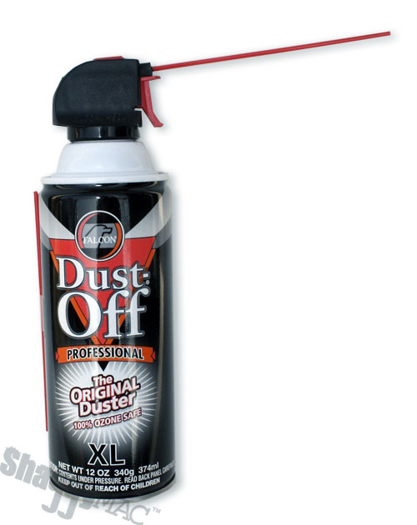
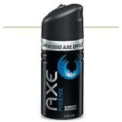
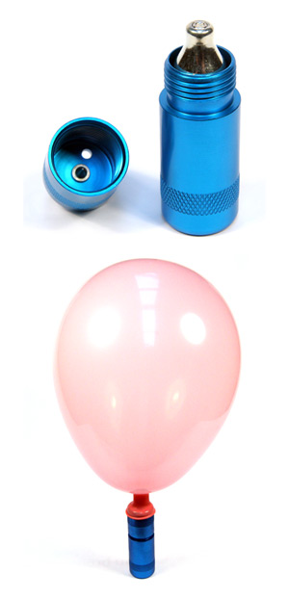
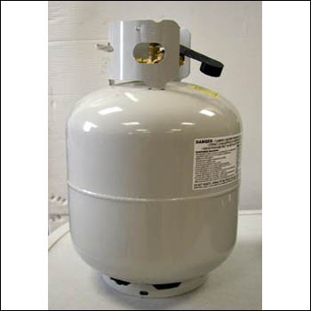
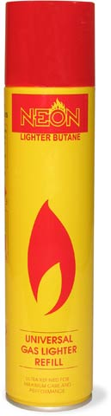
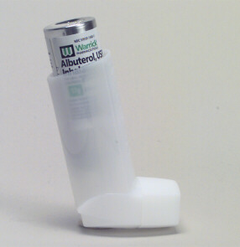

Paraphernalia/Products

Slide 53
Signs of Inhalant Abuse
Inhalant use often leads to problems in school -- failing grades, chronic absences and general apathy.
Other signs include the following:
  Paint or stains on body or clothing
  Spots or sores around the mouth
  Red or runny eyes or nose
  Chemical breath odor
  Drunk, dazed, giddy, dizzy appearance
  Nausea, loss of appetite
  Anxiety, excitability, irritability
http://www.inhalants.org

Slide 54
Potential Long Term Effects
Short term memory loss
Hearing loss
Limb spasms
Permanent brain damage
Bone marrow damage
Liver and kidney damage
Possible fetal effects similar to fetal alcohol syndrome
http://www.inhalants.org

Slide 55
Inhalant Abuse: Special Considerations for
Emergency Medical Personnel
Use extreme caution, trying not to frighten. Any fright may cause sudden cardiac arrest.
Keep in mind that abusers, adult or youth, may be very excitable and given to impulsive or violent behavior.
Medical Assessment of suspected abuser
Take a complete history and perform a full medical assessment if possible: vital signs, mental status, 12 lead EKG
Call the Poison Center at 1-800-222-1222 for product specific information, treatment advice and parent education information
Transfer to medical center if concerned about medical status
Gather suspected products and paraphernalia

Slide 56
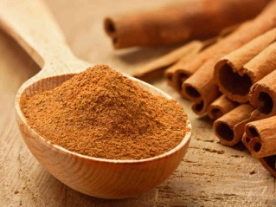
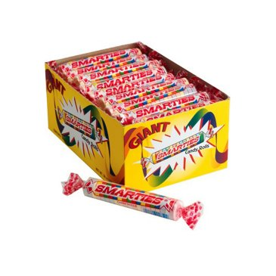
Stupid Teen Tricks
Smart Kiddos Doing Stupid Things
Ice/Salt Challenge
Cinnamon Challenge
Smarties Snorting
Albuterol inhalers

Slide 57
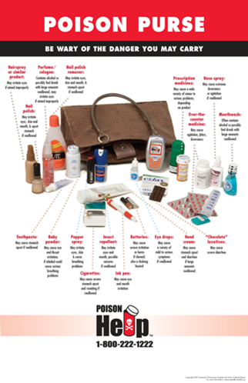
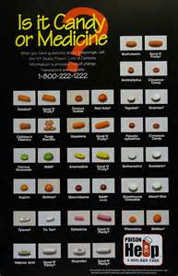
Posters

Slide 58
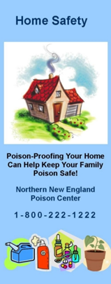

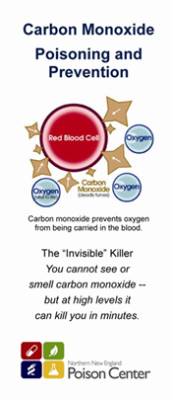
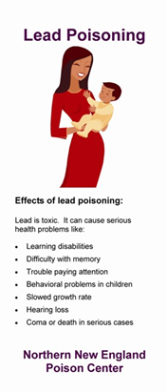
Brochures

Slide 59
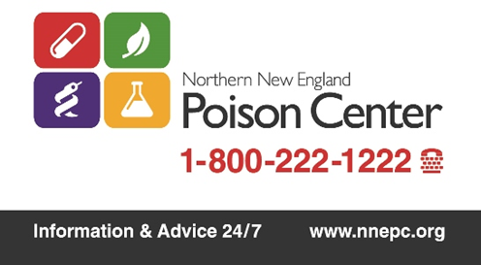


Magnets

Slide 60



Medication Disposal

Slide 61
Education Resources
www.NNEPC.org
Chat: real-time online communication
Blogs by our own Toxicologists and guests
New materials in easy-to-download format
Webinars, fact sheets on emerging issues

Slide 62
Education Resources
www.nnepc.org – sign up for electronic newsletters, find info, order or download educational materials
1-800-222-1222 – call for information or questions
Program your phone right now!!
Vermont Educator: Gayle Finkelstein at
  802-847-2393 or gayle.finkelstein@uvmhealth.org

Slide 63
Education Resources
1-800-222-1222 (Program your phone today!)
www.nnepc.org
Electronic newsletters
  Name Your Poison
  Northern Exposures
Follow us on Facebook, Twitter

